Slide 1
Class 6: Assent

Slide 2
Key questions
Is there an enforceable promise?
Has it been breached?
Was performance excused?
How should the promise be enforced?

Slide 3
Topics
Intent to be legally bound
Alternatives to legal enforcement
Pros and cons of legal enforceability
Manifestation of assent
  Objective and subjective standards
  Content of the objective standard
Justifications for the objective standard

Slide 4
Balfour v. Balfour (Supp)
What was the promise?
Was there consideration?
What other factors did the court consider?
Did the parties intend to form a contract?
  What are the effects of legally unenforceable promises?
  What are the pros and cons of legally enforceable promises?
How could the parties have avoided this result?

Slide 5
Restatement 2d
§ 21 Intention to Be Legally Bound
Neither real nor apparent intention that a promise be legally binding is essential to the formation of a contract, but a manifestation of intention that a promise shall not affect legal relations may prevent the formation of a contract.
c. Social engagements and domestic arrangements. In some situations the normal understanding is that no legal obligation arises, and some unusual manifestation of intention is necessary to create a contract. Traditional examples are social engagements and agreements within a family group.

Slide 6
Cohen v. Cowles Media (135, 183)
“it is no more than the incidental, and constitutionally insignificant, consequence of applying to the press a generally applicable law that requires those who make certain kinds of promises to keep them.”
50 U.S. 663, 672 per White J.
Were the elements of a contract present?
Were the elements of promissory estoppel present?
Can we justify different answers to these questions?

Slide 7
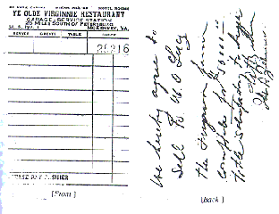
Lucy v. Zehmer (173)

Slide 8
Lucy v. Zehmer (173)
What did Lucy have to prove to establish there was a contract?
Was the fact Zehmer had been drinking relevant?
What test did the court use to determine whether there was mutual assent?
  What if Zehmer did not intend to sell the farm?
  What if Lucy knew that Zehmer did not intend to sell the farm?
  What if Lucy did not know, but should have known, that Zehmer did not intend to sell the farm?
What factors made it reasonable for Lucy to believe that Zehmer intended to sell the farm?

Slide 9
Justifications for the objective standard
Autonomy
  Imposes liability on those who knowingly invoke a convention
Efficiency
  Creates incentives for speakers to avoid misunderstandings
  Avoids litigation costs associated with ascertaining beliefs
Fairness
  Imposes costs on party at fault
Why not require more formalities?

Slide 10
Leonard v. Pepsico (177)

Slide 11
Factors relevant to objective standard
Language
Formality
Definiteness/Completeness
Reasonableness of terms
Foreseeable reliance/part performance
Conspicuousness
Custom
Parties’ self-interest
Course of dealing

Slide 12
Specht v. Netscape (178)
What promise did Netscape want to enforce?
How did the plaintiffs allegedly manifest assent?
Why did this not constitute assent?
To what terms, if any, did the plaintiffs assent?
How do you expect Netscape to respond?
Will this guarantee “informed assent”?

Slide 13
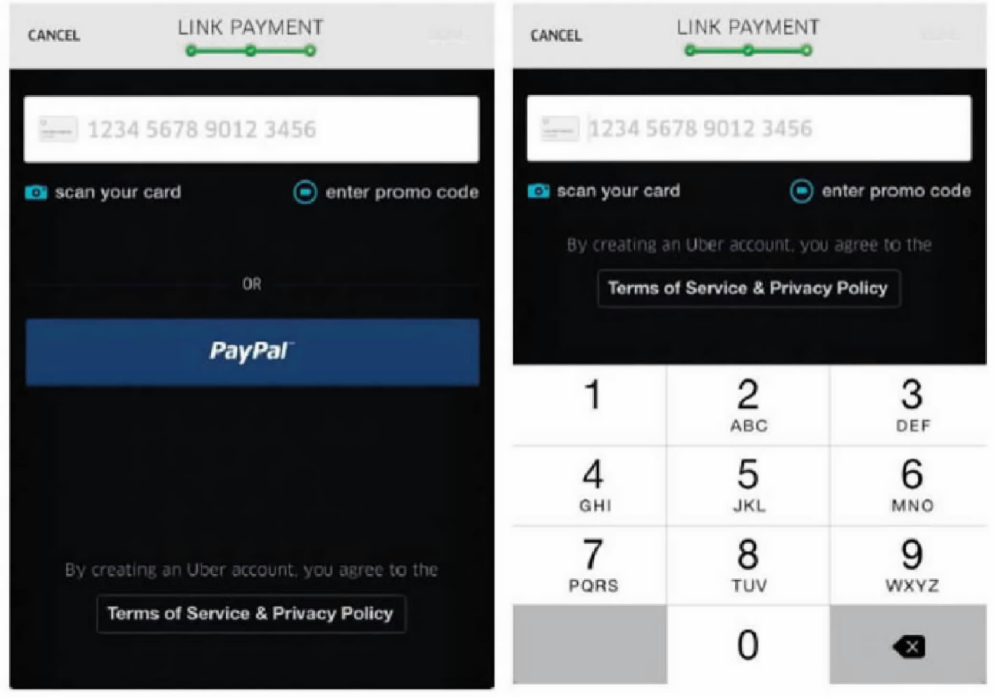
“Done” appears here once payment info is entered.
Cullinane v. Uber Technologies, Inc., 893 F.3d 53 (2018)

Slide 14
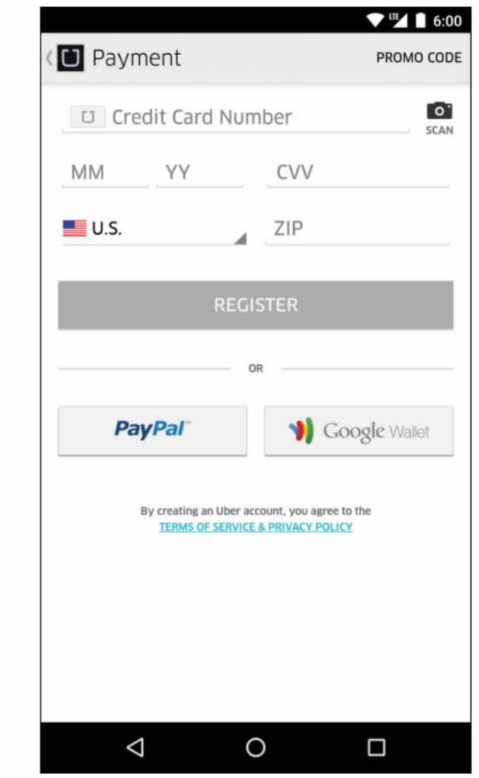
Meyer v. Uber Techs, Inc. 868 F.3d 66 (2d Cir. 2017)*
*Applying California law.

Slide 15

Cullinane v. Uber Technologies, Inc., 893 F.3d 53 (2018)
Meyer v. Uber Techs, Inc. 868 F.3d 66 (2d Cir. 2017)

Slide 16
Restatement of the Law of Consumer Contracts
§ 2. Adoption of Standard Contract Terms
(a) A standard contract term is adopted as part of a consumer contract if the consumer manifests assent to the transaction after receiving:
(1) a reasonable notice of the standard contract term and of the intent to include the term as part of the consumer contract, and
(2) a reasonable opportunity to review the standard contract term
Cmt 3….This Section does not address the formation of the contract or the assent to nonstandard terms. Once the contract is formed, this Section determines which standard contract terms are adopted.

